Slide 1
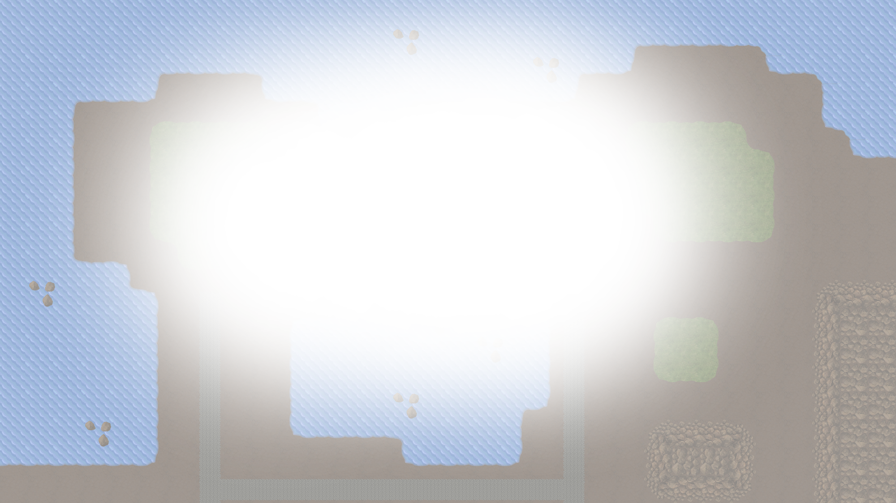






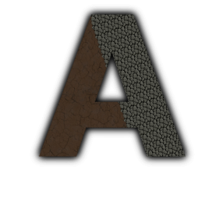


Majaro – Matt, James, Rob
Majario – Matt, James, R(i)ob
Notes:
TOTAL TIME [ 40 – 40 – 30 – 30 – 30 – 60 – 90 – 20 – 30 – 40 - 30 > 440s / 7.20min ]

Slide 2
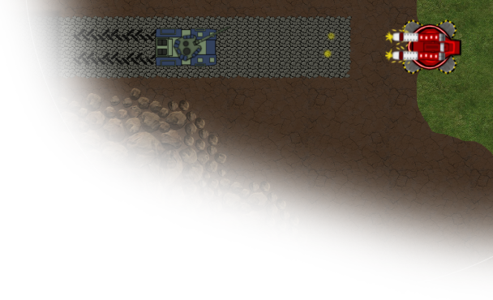
Game Origins
Considered genres;
Reaction (Mario Party)
Simulation (Sims)
Board Games (Risk)
RTS (Age of Empires)
Agreed on an RTS Genre taking inspiration from Command & Conquer Tiberium Twilight
Resultantly we felt by being browser-based for accessibility and by implementing a full top-down implementation our game was unique.
Notes:
ORIGINS [ 40s ]
Considered genres of games which we had all played in the past, suggesting several proposals for ideas and debated why we thought we should make our proposed games.
Voted on our top three favourite proposals and selected the one with most votes, with an RTS style game being the clear winner
Took inspiration from games like Tiberium Sun, Tiberium Twilight, Generals, Star Craft and Age of Empires
Discussed what we thought was missing from our inspirations and what we thought we could achieve in the time we had, with some time spent thinking of future features we could include

Slide 3
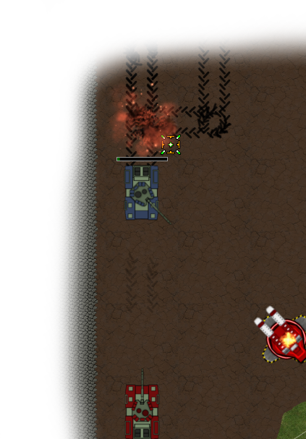
Project Strategy
Created feature plan for the game
Tailored the plan for scalability
Fundamentals implemented first
Once stable extra features were added
Testing occurred semi-regularly
Features tested on implementation
Sam and Steve tested ‘stable’ builds on Fridays
Alpha testing was done by friendly office testers
Notes:
PROCESS [ 40s ]
Drew up a plan of a game including all the features we wanted to be present
Broke the game into development stories prioritising those which created the core game. Our first priority was creating firing turrets and moving tanks
Game was implemented a module at a time until we had a basic and reasonably stable engine which we could expand upon
Testing of the game occurred through user acceptance testing. The game was tested after the addition of each feature. We tried to create a stable build each Friday for testing by Sam and Steve

Slide 4
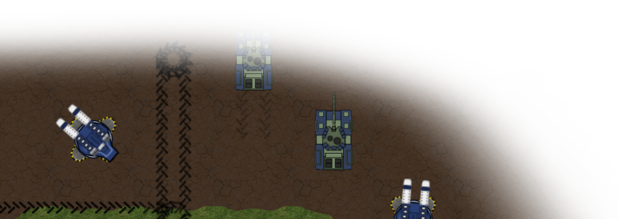
Project Strategy Rationale
Core functionality completed first to assure a stable functioning game
Weekly Friday meetings allowed us to stay on track and judge progress
Regular testing helped us locate and fix bugs as soon as they occurred
Notes:
WHY [ 30s ]
Used weekly Friday meetings to keep us on track and get external opinion on our progress
Automating game testing was very difficult and we found it more productive to use user acceptance testing to both locate bugs and balance gameplay

Slide 5
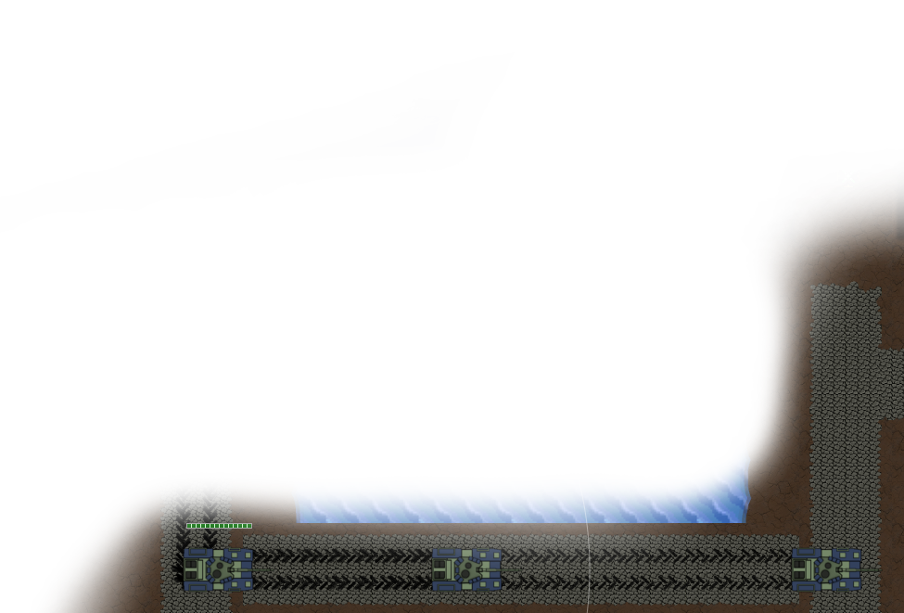
Key Technologies
Backend Server:
Java, Netty, REST Easy, MySQL
Frontend Client:
Angular, Phaser, HTML5, CSS3, SocketIO
Other:
GIMP 2.8, Git, JIRA, Eclipse
Notes:
TECHNOLOGIES [ 30s ]
State the main technologies used in the project and say where they were used/what they were used for
Mention extra detail for each of the above technologies, notably:
Netty : Socket IO implementation
Phaser : Pixi-powered JavaScript game engine
GIMP 2.8 : Creating images/sprites/animations

Slide 6
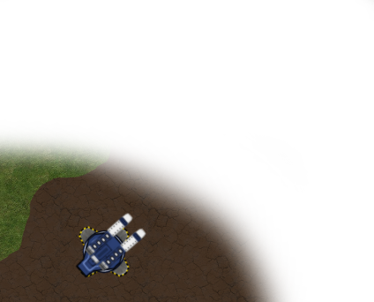
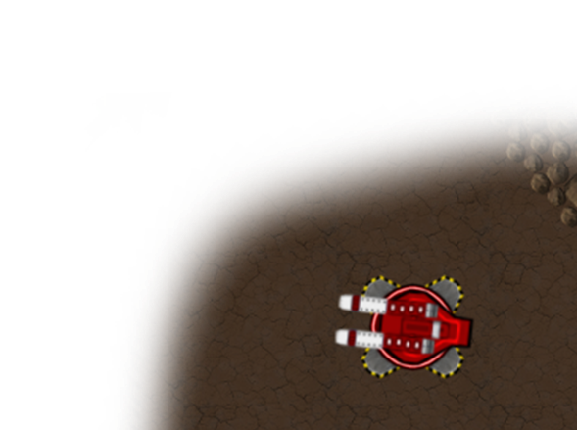

Technology Rationale
Chose relevant technologies usable beyond the project
Java Server, Angular Client, MySQL Database
Phaser.js used for client game engine
Technology chosen for a more comprehensive learning experience
Notes:
WHY [ 30s ]
Partial reason is familiarity with languages so we weren’t using languages none of us had ever seen. Also helped teach others who weren’t familiar with languages
Chose to use software which would help us learn technologies we would be using once the grad project was finished. Used Java and MySQL partially because they are used in client work and this was a great opportunity to practice
Phaser chosen as it supported WebGL and Canvas along with being a very popular free JavaScript engine

Slide 7
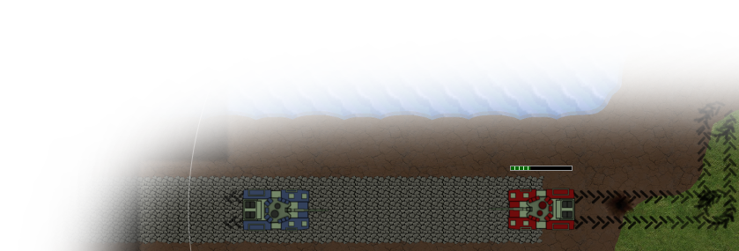
Project Progress Diary
Week 1 :
Brainstorming, Approach to development, Proof of concept for some technologies, Game engine research, Server skeleton constructed
Week 2 :
Game Engine & Netty PoCs, UX web application design, Clientside turrets, Work on Login, Registration & Servers
Week 3 :
Work on UI, Socket server constructed, Work on Game Lobby, Server engine skeleton constructed
Notes:
DIARY 1 [ 60s ]
Week 1 :
Brainstorm ideas for the game
How we would approach the development of it
Created a working proof of concept for various technologies (REST, Java-Tomcat, Angular, MySQL)
Research for best JavaScript game engine
Server skeleton constructed
Week 2 :
Created proof of concept for Phaser game engine and Netty
UX design for web application flow (from login to starting a game)
Turrets constructed on client side in Phaser
Work on Login, Registration & Server Lobby
Week 3 :
UI designed and implemented (stole background image without getting caught)
Began creating socket code for project use
Work on Game Lobby
Constructed skeleton for serverside engine

Slide 8
Project Progress Diary
Week 4 :
Implemented path finding, cross computer game sync, game and server lobby work continued
Week 5 :
Sockets migrated to single unit, created two maps, Implemented; HUD, target selection, damage calculation and tank hub building
Week 6 :
Game balancing, added extra map, bug fixes (clearly not enough), Implemented; unit formations, map navigation, autofire, build radius
Notes:
DIARY 2 [ 90s ]
Week 4 :
Implemented path finding
Engine working cross computers / browsers
Work on game lobby and server lobby
Week 5 :
Migrated all clientside socket code to single unit (help reduce socket disconnections)
Created two and four player maps
Implemented HUD
Implemented unit/turret lockon/tracking
Implemented damage for units/defences/buildings
Implemented tank hub
Week 6 :
Implemented fog of war
Game balancing
Units move in formation
Map navigation (right and middle mouse)
Autofire for turrets and tanks
Build radius around tank hub
Extra four player map added
Bug fixes

Slide 9
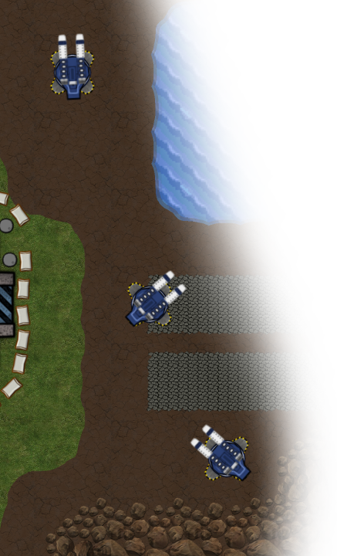
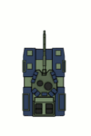
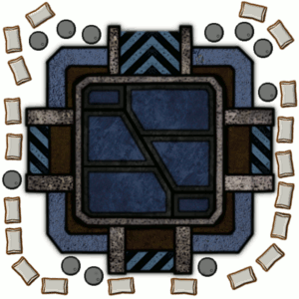
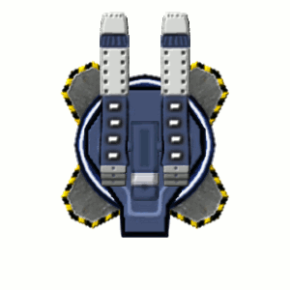
Creating Assets
Created using GIMP 2.8
Original sprite designs
Notes:
ASSETS [ 20s ]
- Blag about how sprites were made a little

Slide 10
Scalability
Large consideration during engine design
Addition of new game items is quick and easy requiring few changes
Good practice for creating modular and extensible
Notes:
SCALABILITY [ 30s ]
Project scalability was a large consideration during many development decisions for the engine
Addition of new units/buildings/defences is very quick requiring a couple of additions to the constants file on server and client side
Gave us good practice in creating software which may be expanded upon at a later time

Slide 11
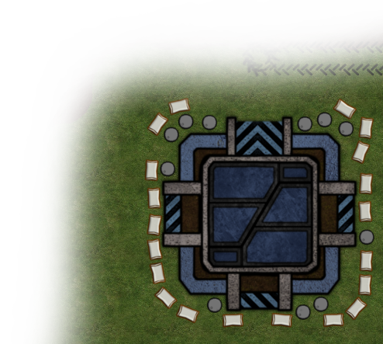
Challenges
Learning new technologies
Netty sockets and its quirks
Random disconnects cost lots of development time
Project management
Overly ambitious
No solid idea of exactly what features we would deliver (up in the air)
Software Issues
Git not utilised as well as it could have been
Eclipse. Just Eclipse.
Notes:
CHALLENGES [ 40s ]
Learning technologies we were not currently familiar with
Netty causing many issues with random disconnects resulting in losing days worth of development time
Overly ambitious original idea and needed a more solid idea of what we would be delivering
Git committing files incorrectly and not using branches from the start
Eclipse causing plenty of problems

Slide 12
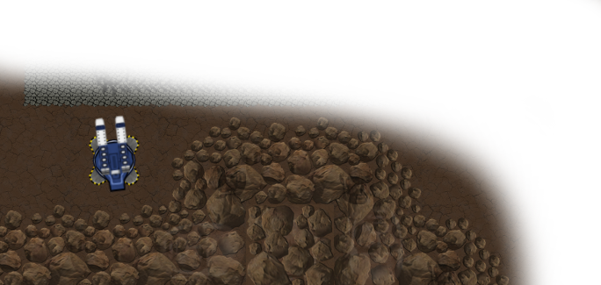

What would we do differently?
More thorough weekly plans
Implement a single feature at a time
Use a different IDE (out of the hundreds available…)
Notes:
DIFFERENTLY [ 30s ]
Better weekly plans, including correct use of sprints
Implement a single feature at a time. Problem was partially caused by issues on JIRA being much to broad when they should have been several minor specific tasks

